Slide 1
The ABCs OF PURCHASING
The CCCS Purchasing Process
January 2014

Slide 2
Purpose
To ensure compliance with State of Colorado Fiscal Rules, Procurement Code, Personnel Rules, System Policies and Procedures
To ensure that every procurement is documented appropriately
To abide by the State of Colorado Code of Ethics
To work smarter not harder

Slide 3
What do I need to do?
Ask yourself this…..
Types of purchases: Travel, goods, services
Rules and requirements
Back-up documents
Be sure to…..
Purchase Requisitions
Payment Authorizations for Services
Solicitations
Allow plenty of time
Consider this….
Invoices
Pcards
Unauthorized Purchases

Slide 4
Is this purchase travel related?
Travel related purchases would be placed on a travel card.
PCards may not be used for travel related expenses.
Individuals pay the bank bill and then submit a Travel Expense Reimbursement form.
An ARF is generally required for reimbursement.
No personal purchases permitted.
Subject to Fiscal Rule 5-1
Meals generally not allowed for single day travel
Meal Per Diems apply for overnight stays (75% on day of travel)
Receipts required for non-meal or mileage expenses
Reimbursement submitted within 60 days of first day of travel
See CCCS Travel Guidelines and Tips for more details

Slide 5
Is this purchase IT related?
All IT related purchases must be made through the IT department
Includes software, hardware, keyboards, iPads, computer accessories and peripherals
Submit a request by contacting Chris St. Clergy at chris.stclergy@cccs.edu or at extension 2266
Include as much detail as possible – software version, make, model
IT will either
Generate a PR for the order, bring to you for signature, and process the order
Send an email as approval for you to place the order. Be sure to attach a copy of the approval as backup.

Slide 6
What else do you need to think about?
Do I have the authority to purchase?
I am Org code owner or have delegation
Do I have the approvals I need?
Email approval for non-delegated orgs
Are sufficient funds available?
Am I getting a fair, reasonable price?
Am I buying goods or services?

Slide 7
Do I need to bid this?
How much am I spending?
Contact Purchasing if bid is required

Slide 8
Am I buying goods or services?
What is a good (aka commodity)?
An item that you are buying “off the shelf” – something any other person might also want to buy.
Includes out of the box software, office supplies, cleaning supplies, groceries, bagels from a bin, tractors, etc.
What is a service?
Anytime you ask a person to do something for you.
A purchase can begin as a good and end up as a service: water bottles that are customized
Includes advertising, printing, catering, background checks, repair work, guest speakers.
Contact Purchasing if you aren’t sure.

Slide 9
Is my service vendor an independent contractor or an employee?
Employees
Perform duties dictated or controlled by others.
Receive state resources/tools to perform the work
Are given training for work to be done.
Work for only one employer.
Receive benefits such as insurance, pension, paid leave.

Slide 10
Independent Contractor or Employee? (con’t)
Independent Contractors
CCCS does not direct or control how work is done.
Operate under a business name.
Invoice for work done - Paid on a fixed or contract basis.
Have more than one client.
Control the business aspects of their business
Have their own tools and sets their own hours (CCCS does not provide telephone or computer)
Keep their own business records
Supply their own supplies and services
Pay their own expenses
Provide their own workers comp and unemployment insurance
May realize a profit or incur a loss

Slide 11
What about former CCCS staff?
RETIREES
Are the duties the same or similar to the duties carried out prior to retirement?
Are they within 6 months of the date of retirement?
If yes to either of these questions they are an
employee and must be put in a 9 month temp or
part-time permanent position!

Slide 12
What if I want to hire college staff/faculty for a small project?
CCCS College Employee
Permanent employee or temporary adjunct?
Performing same or similar duties?
Prior college or system employee (duties, length of separation)?
Probably an employee and if currently employed an
MOU is required.

Slide 13
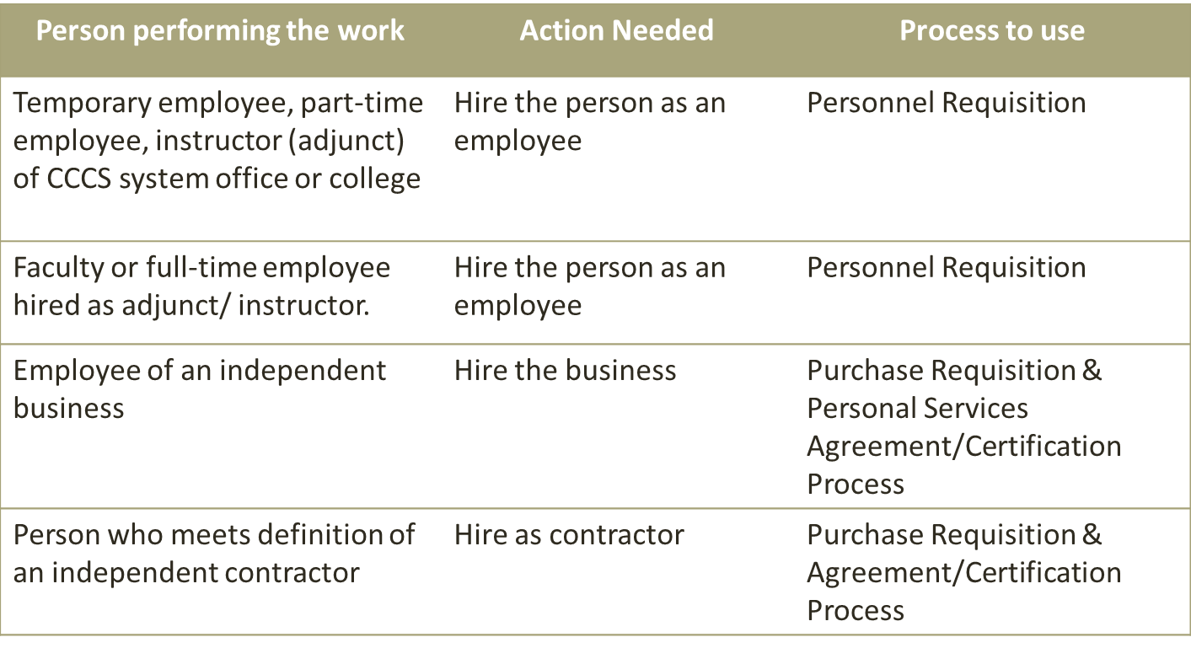
Do Not Need Mou:
People
Agreement

Slide 14
When to Use
People
Agreement
If project/work is to be completed over multiple fiscal years – complete separate MOU for each fiscal year

Slide 15
Is there a price agreement?
Office supplies, cleaning supplies, toner and ink cartridges:
EON, Office Max, Sun Office Products, Source Office & Technology, Beyond Technology
MetroOffice Solutions
computer software and hardware, temp services, small package delivery (UPS & FedEx), drug & alcohol testing
Price agreements were solicited and so can be used for any purchase amount
PO still required if over $5,000 in a year

Slide 16
What documents do I need?
Approval Request Form (ARF)
Under $100 may be signed by Supervisor/VP only
Over $100 - submit to Alice Duran for processing
If revision is needed, make changes on a copy of the original, mark it as a revision, submit to Alice Duran
Used for purchases involving travel, meeting expenses, and/or food
Used for all registrations: conferences, webinars, classes, workshops
May be goods or services

Slide 18
Workshop/Conference/Travel Calculation Sheet
Meeting/Conf: | NAEP National Conference
Location: | San Francisco
Date: | May 10-15, 2012
 |  |  |  |  |  |  | Eff. 7/1/11
 |  |  |  |  |  |  | ($.50 mile)
Name | ORG CODE | Air Fare | Hotel | Meals* | Airport Parking | Rental Car | Mileage Cost |  | Est. Misc.** | Other - | TOTAL
Terry Hindsman | 116210 | $ 425.00 | $ 800.00 | $ 77.00 | $ 75.00 | $ 325.00 | $ 75.00 |  | $ 25.00 |  | $ 1,802.00
 |  |  |  |  |  |  |  |  |  |  | $ -
 |  |  |  |  |  |  |  |  |  |  | $ -
 |  |  |  |  |  |  |  |  |  |  | $ -
 |  |  |  |  |  |  |  |  |  |  | $ -
 |  |  |  |  |  |  |  |  |  |  | $ -
TOTAL |  |  |  |  |  |  |  |  |  |  | $ -
*Meals not served at the workshop include: |  |  | Lunch & Dinner on travel day, breakfast and lunch on return
**Miscellaneous contains possible taxi charge/other.
Other Notes:
PER DIEM
MEALS | Day 1 | Day 2 | Day 3 | Day 4 |  |  | Denver/Aurora Rates 10/2011:
Breakfast Costs: |  |  |  | $11.00 |  |  | $11.00
Lunch Costs: | $16.00 |  |  | $16.00 |  |  | $16.00
Dinner Costs: | $34.00 |  |  |  |  |  | $34.00
Incidental: |  |  |  |  |  |  | $5.00 | Incidental
TOTAL | $ 50.00 | $ - | $ - | $ 27.00 | $ 77.00 |  | $66.00

Slide 19
What documents do I need? (con’t)
W-9 Tax Identification Number
Required to have on file for ALL vendors
Use the form found on CCCS website where possible
Simply checking LLC is not enough – need to know what the filing status is.
Ensure that it is legible
M/WBE information at bottom is preferred for our state reporting - but not required
If you have a foreign vendor, contact Kristine Shepard at the beginning of the transaction (and never use a PCARD)

Slide 21
What documents do I need? (con’t)
Scope of Work – used for services
Used to set out the details of the work to be performed in the absence of a formal contract
Includes PERA Retiree certification
Includes payment and billing details
Travel expenses are not normally included for independent contractors
In the few cases where travel is necessary, must be approved by fiscal prior to signing.
Advance payments are a risk to the state and should not be included. Obtain advance approval from fiscal before agreeing to an advance payment.

Slide 23
What documents do I need? (con’t)
PERA Retiree Questionnaire for Personal Services Contracts
Used in the absence of the Scope of Work with PERA section

Slide 24
What documents do I need? (con’t)
Exhibit C - Independent Contractor – used for services
Required by Attorney General’s office to aid in differentiating independent contractors from employees
Required for all single entity owners regardless of dollar amount – could include LLCs and corporations
Attaches as an Exhibit to the PO
New Exhibit is required for each PO issued – cannot be kept on file and reused
Note: the Unauthorized Immigrant Form is no longer a required form

Slide 25
What documents do I need? (con’t)
Insurance
State requires certain levels of insurance
Risk based assessment – what is our level of risk when purchasing services?
High risk – trades people, IT related
Low risk – caterers, off-site consultants/contractors, guest speakers
Purchasing department will assess the need for you

Slide 26
What documents do I need? (con’t)
Personal Services Contract Review
CONTRACT PROCESS AND REQUIREMENTS
Departments must insure compliance with all personal services review requirements. This includes developing plans that identify how the internal review process will be conducted and having processes in place to ensure compliance with statutory requirements and the Director’s Rules.
Departments must have at least one HR professional with a certificate in the Personal Services Contracts modules of the Personnel Certificate Program to conduct personal services reviews.
The review includes all contracts, purchase orders, and solicitations
An HR professional must ensure completion of all personal services documents, such as certification forms and pre-approvals.

Slide 27
Waiver of Personal Services Review
HR administrators may issue internal personal services review waivers, in accordance with C.R.S. 24-50-511, for services provided that a detailed analysis is conducted that demonstrates his or her knowledge of the department’s contracting activity.
Types of Services Included on the Waiver
Catering/Coffee Services
Internet/Cell Phone
Temporary Services
Advertising
Guest Lecturer
Consultants
Construction
Building and Grounds Services

Slide 28
Be sure to …. Complete a purchase requisition
POs must be in place before the purchase
Be sure to use the latest version (on the web)
Complete Purchase Req filling in all information
Vendor email is required – vendor S# would be appreciated
Provide both org code and commodity code
Obtain appropriate signature for the dollar level of the PR
Perkins – when using roll forward dollars, must obtain sign off from Scott Stump

Slide 29
…..purchase requisitions (con’t)
Goods
Purchase Req only needed if purchase is over $5,000
Under $5,000 use Pay Direct or PCard
Attach any applicable quotes
Be sure to include shipping when applicable
Services
Check Approved Vendors for Services list – no PR required
Purchase Req needed for non-approved vendors and all purchases over $5,000 – even if there is a contract
Consider how the vendor will be billing
Regular POs – quantity times rate. For example, Vendor will bill by the hour at a rate of $x.xx
Standing POs – billing amount fluctuates. For example, Vendor bills for multiple phases at differing rates
Can’t switch from one type to another with a change order – have to delete and re-issue the PO
Attach back-up documents and get approval – be sure that approver has authority for dollar amount
Blanket POs can be set up for frequently used vendors – but if over $25,000, must bid

Slide 30
Be sure to…allow plenty of time.
Here’s the fiscal process for purchase requisitions:
PR is added to PO log
Check for required documents – follow up with requester or vendor as needed
W-9
Approval Request Form
Scope of Work
PERA Retiree information & forms
Exhibit C – Independent Contractor
Certificate of Insurance

Slide 31
Fiscal’s process (con’t)
Check for appropriate org and commodity code
Check that the approver has appropriate authority/delegation for the dollar amount
Obtain sign off from grants for use of all 13xxxx orgs
Check for federal grants requirements as needed (SAM)
Route to HR for personal services sign off, if needed
Obtain approval from controller
Can a Payment Authorization for Services be issued?
Purchasing Manager signs off, copies onto yellow paper, and returns to requester
Is a PO required?
Enter into Banner and issue PO
POs are scanned and emailed to both the vendor and the requester

Slide 33
Be sure … that you don’t need to bid it.
For Goods
Documented Quote (DQ)
Between $10,000 and $150,000
Post a minimum of 3 days – prefer 1-2 weeks
Invitation for Bid (IFB)
Over $150,000
Post a minimum of 15 days- prefer 30 days
For both types
Requester works with Purchasing to provide specs
Award to apparent lowest cost vendor

Slide 34
Solicitations (con’t)
For Services
Documented Quote (DQ)
Between $25,000 and $150,000
Used when specs are known and clear
Some subjective criteria allowed for quality
Post minimum of 3 days – prefer 1 week
Allow time to work with Purchasing to develop specs
Price is primary consideration but may consider other factors
Informal process

Slide 35
Solicitations (con’t)
For Services (con’t)
Request for Proposal (RFP)
Over $25,000
Used when specs are not clear – know the outcome you want, but not sure on how to get there
Post for a minimum of 30 days
Total time line can be as much as 6 months - including time to develop the Statement of Work/Requirements, Posting, Evaluating, and Contracting
Formal process – closed bids evaluated by a team
NOTE: Due to the CORE conversion, bids should not be posted between May 1 and July 1. PLAN AHEAD!!!

Slide 36
Solicitations (con’t)
Sole Source
Used when only 1 product or service will work and there is only 1 vendor who provides it
Requester provides justification for both positions
Is not used because:
you have run out of time
you want to use a particular vendor
Post on BIDS for a minimum of 3 days
Any challenges mean a bid is required

Slide 37
Consider how to pay for it.
General requirements – all types
Check to be sure that the vendor’s math is correct and that the bill amount is correct (check your agreements and SOWs)
Sign and attach any packing slip
Sign off on invoices as received and okay to pay – your signature verifies that the product/services has been received AND that the invoice is accurate
Provide org and commodity code if no PO or Payment Authorization is attached
Be sure all necessary back up documents are attached – could be ARFs, Payment Authorizations, list of attendees for meetings
NOTE: AP’s deadline for payments is noon on Thursday for the following Tuesday check run

Slide 38
Payments (con’t)
All purchases on a PO
Check that the billing method matches the PO (regular or standing)
Break down invoice by line
Attach copy of PO to invoice – every time, please
Goods under $5,000
PCard within your single purchase limit
Invoice and Pay Direct if over
Services under $5,000
Invoice or PCard within your single purchase limit
Payment Authorization for all vendors not on Approved Vendors for Services list.

Slide 39
Using CCards
No Colorado State Sales Tax – must document efforts to receive credit
Reallocate within 2 weeks
Prohibited transactions
Need to have SSB forms on file before you can reallocate. Access needed is “Both”
If your funds change from year to year, you will need to complete a new SSB form on July 1
Need to have current signature delegation form on file

Slide 40
Using CCards (con’t)
Statements with all back up documents are approved by Approving Authority and submitted by the 15th of the following month.
We audit every month for:
Monthly Certification and Approval
Reallocation screen shot (don’t need the Banner email)
Itemized receipt
ARF and other approvals as needed
Prohibited transactions: taxes, alcohol, split purchases
Violation Notices
Are sent to cardholder – in mailbox
Explanation provided by cardholder and signed
3 strike policy
Signed by Approving Authority and returned to purchasing

Slide 41
Unauthorized Purchases
Any situation where a purchase has occurred or a purchase commitment has been made to a vendor to obtain goods or services and:
Purchaser has not followed established applicable purchasing statutes and rules, or
Purchase is made by a person(s) who is not so authorized
Remedies
Ratification – employee completes ratification form with description, explanation of violation and supporting docs. VP Finance sends to State Controller’s Office for approval.
Liabilities – should the State not ratify the purchase
The head of the agency and the employee are personally liable for the costs

Slide 42
Final thoughts
This is the state of purchasing today
As we all know, changes happen. When they do, we will communicate via email
For particularly complicated changes, we will schedule meetings
Please, please contact any of us in the fiscal area. We are all happy to answer questions

Slide 43
Questions?
Did I leave anything out?

